Slide 1
Final review
Four questions five topics:
Waveform for flip flop.
Stable table, circuit diagram, Boolean expression.
Conversion between Moore and Mealy
State reduction.
Circuit design(from the state diagram)

Slide 2
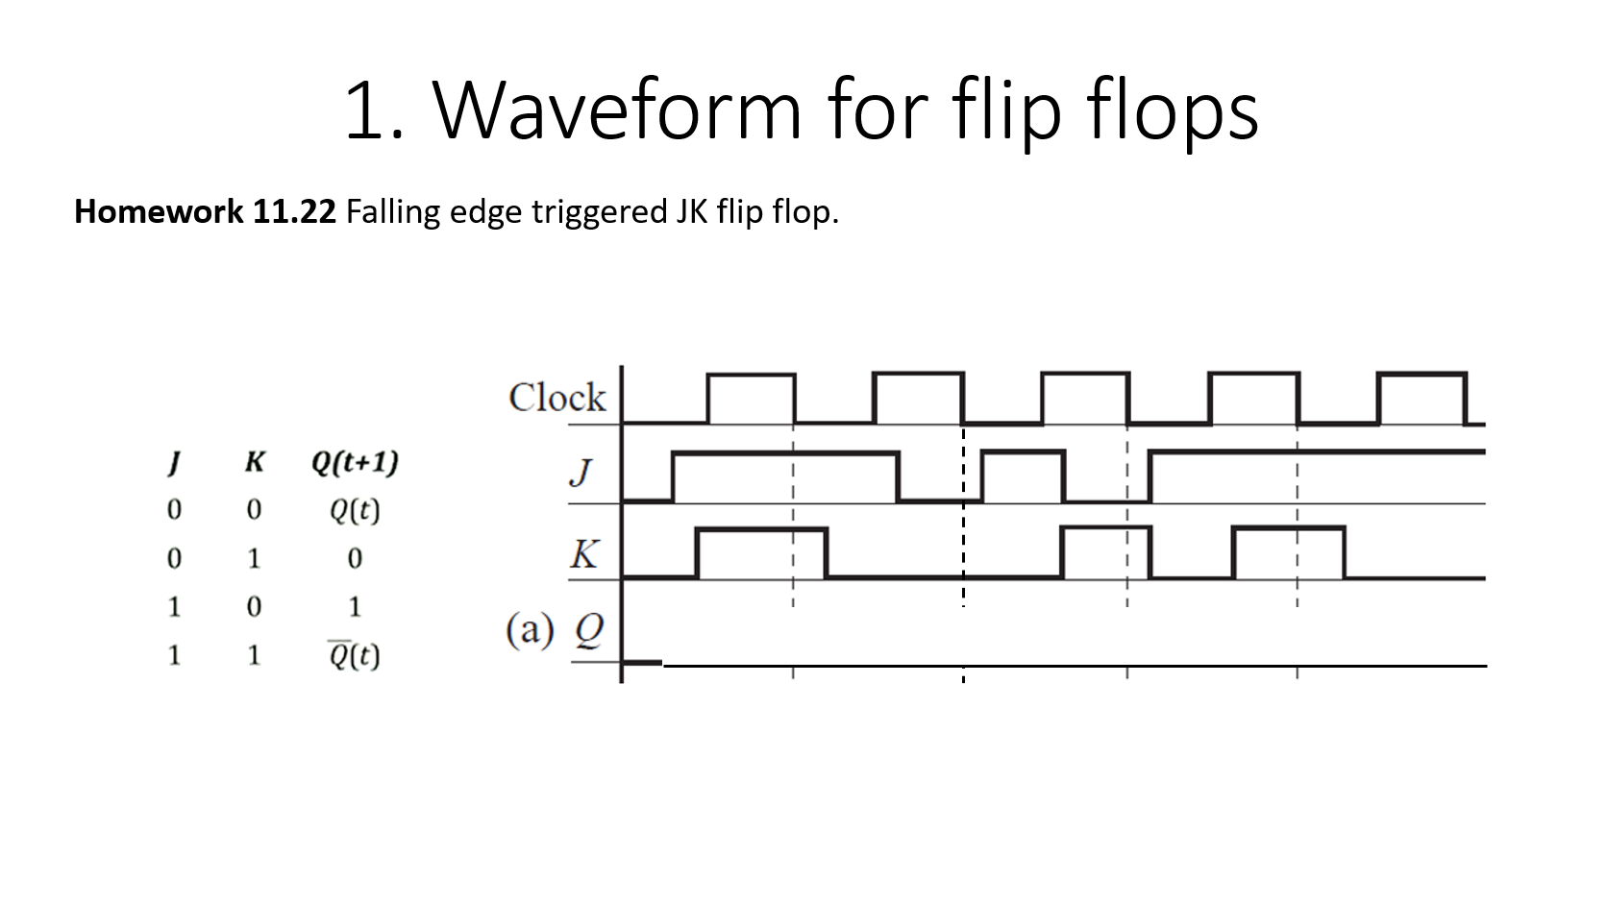
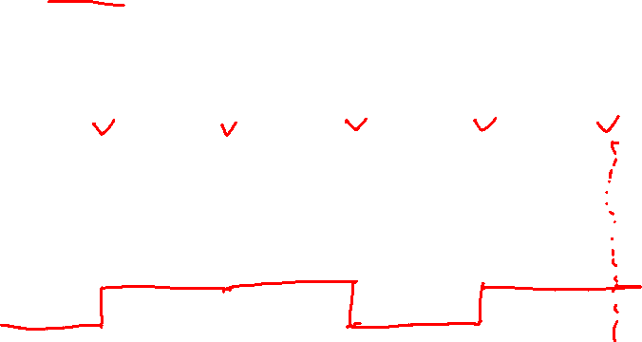

Slide 3
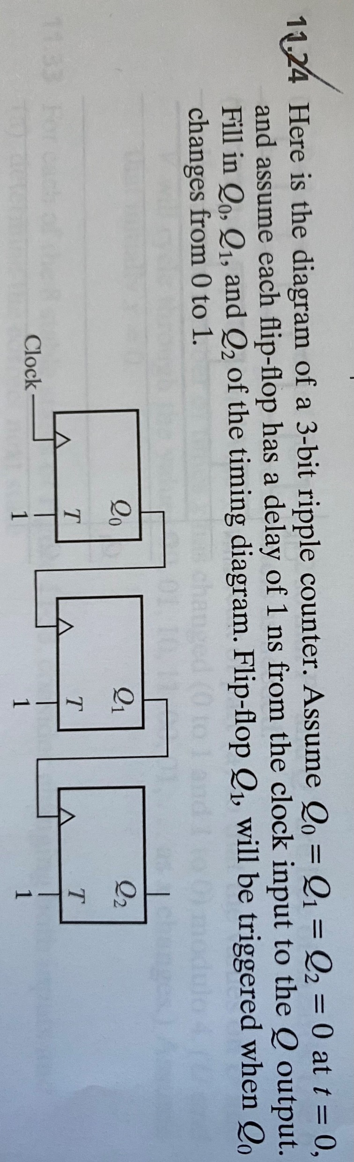
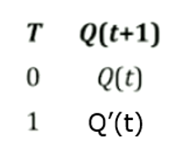
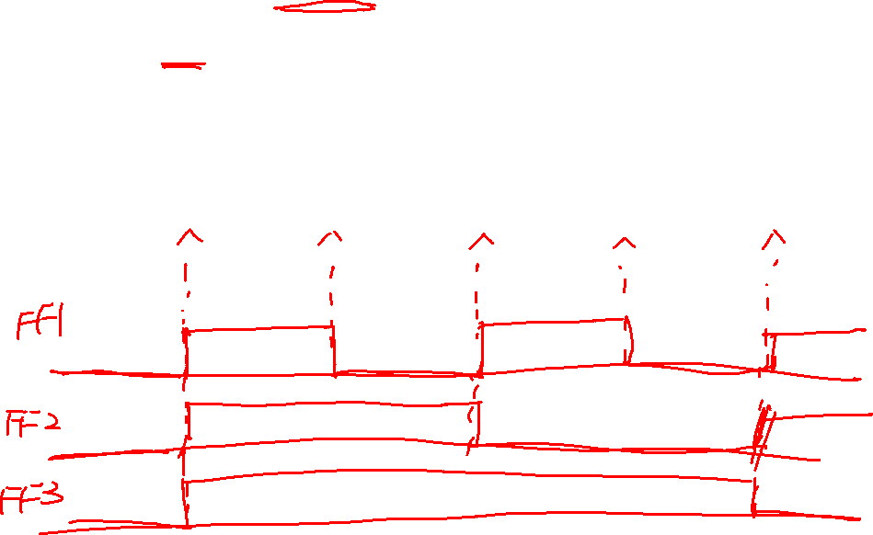

Slide 4
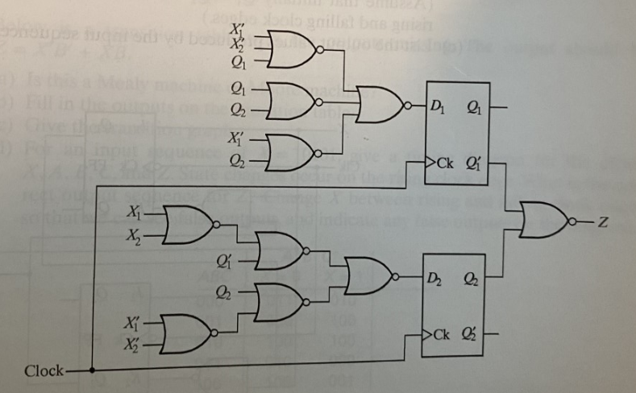
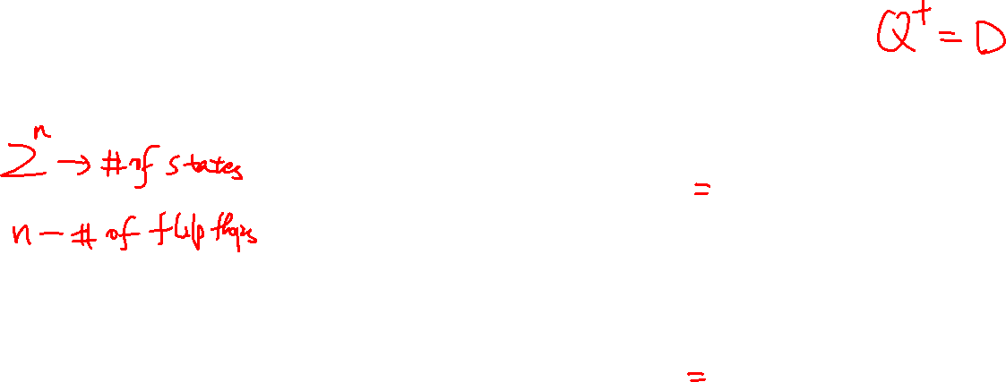
2. Stable table, circuit diagram, Boolean expression
Homework 13.9(a) Construct the transition table and state graph for the circuit

Slide 5
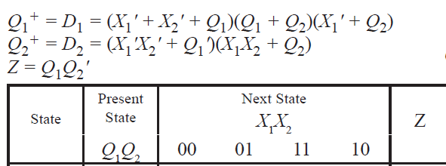
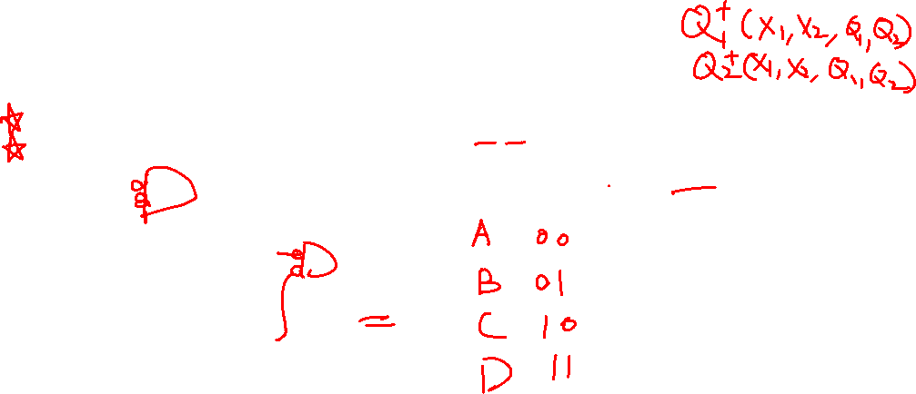
2. Stable table, circuit diagram, Boolean expression
Homework 13.9(a) Construct the transition table and state graph for the circuit

Slide 6
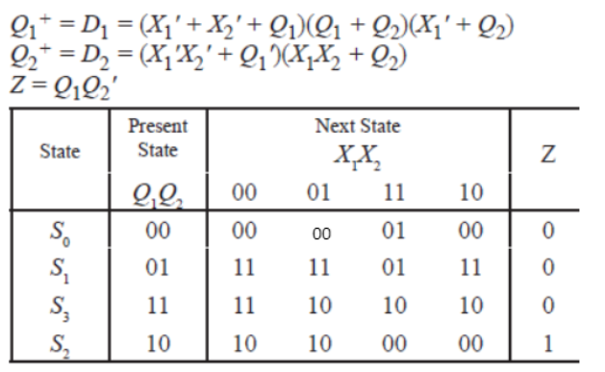
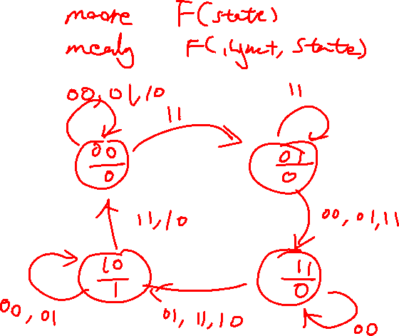
2. Stable table, circuit diagram, Boolean expression
Homework 13.9(a) Construct the transition table and state graph for the circuit

Slide 7
2. Stable table, circuit diagram, Boolean expression
Homework 13.9(a) Construct the transition table and state graph for the circuit

Slide 8
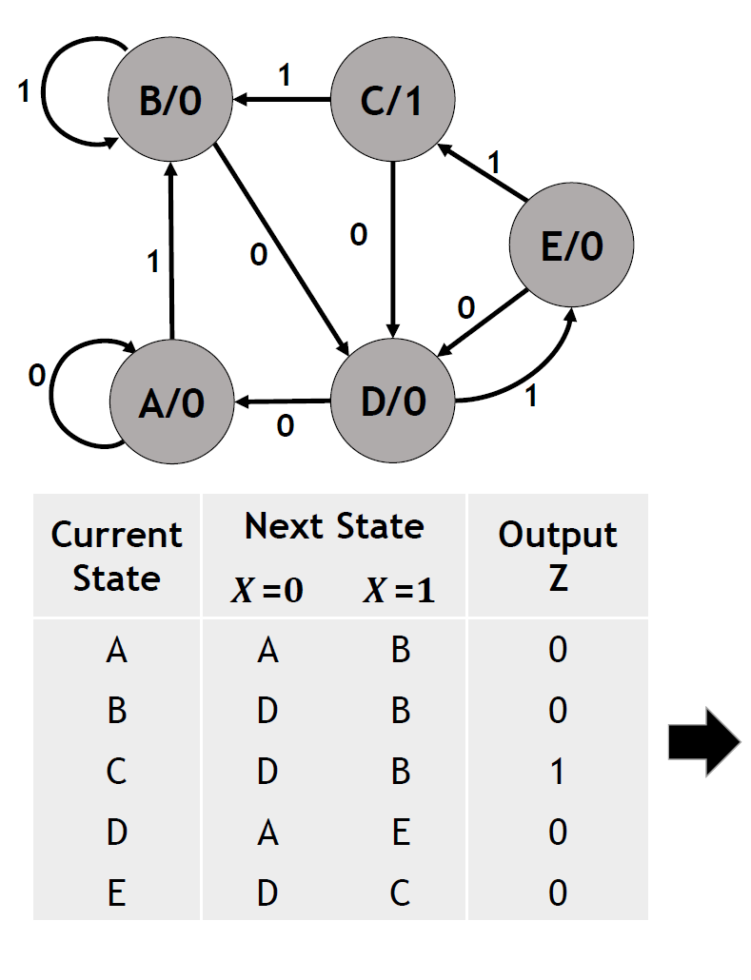
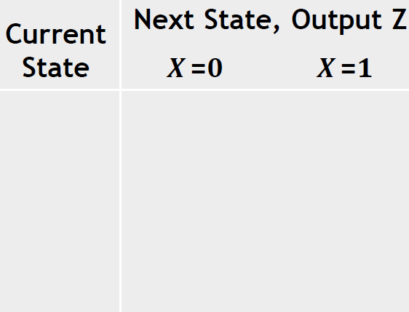
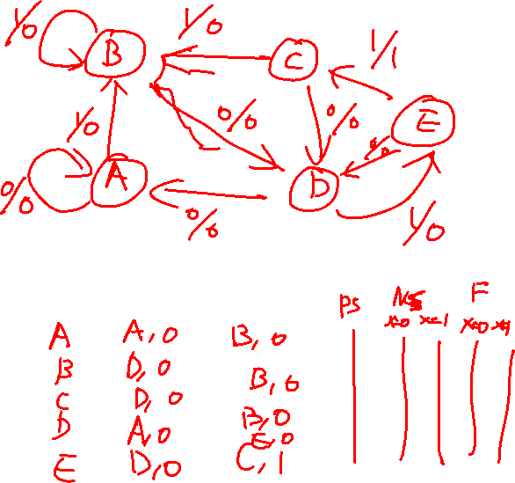
3.Moore and Mealy transition

Slide 9
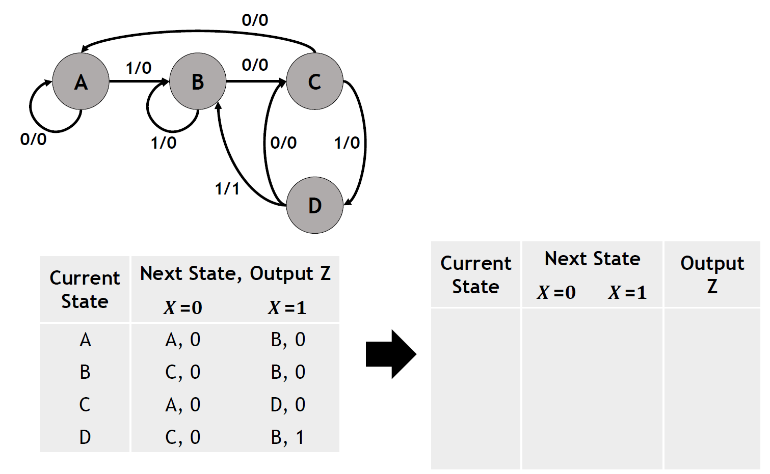
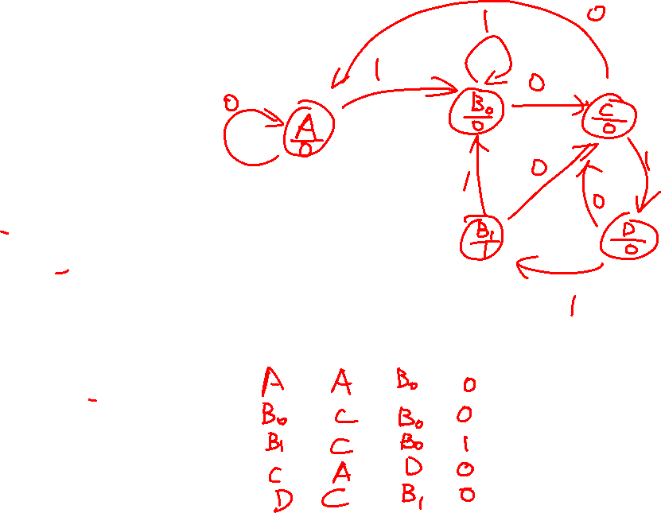
3.Mealy to Moore transition

Slide 10
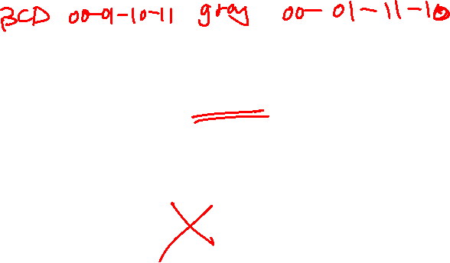
5. Circuit design
1.Derive the state diagram from the word description and specifications of the desired operation
2.Reduce the number of states
3.Assign binary values to the states
4.Obtain the binary-coded state table
5.Choose the type of flip-flops to be used(D flip flop)
6.Derive the simplified flip-flop input equations and output equations
7.Draw the logic diagram(Simulink)

Slide 11
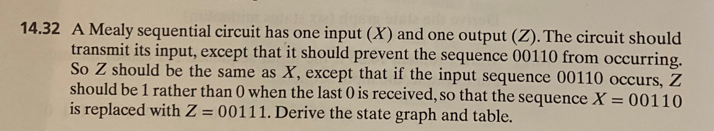
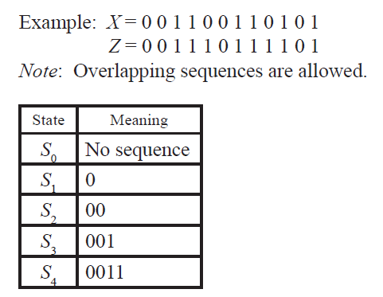
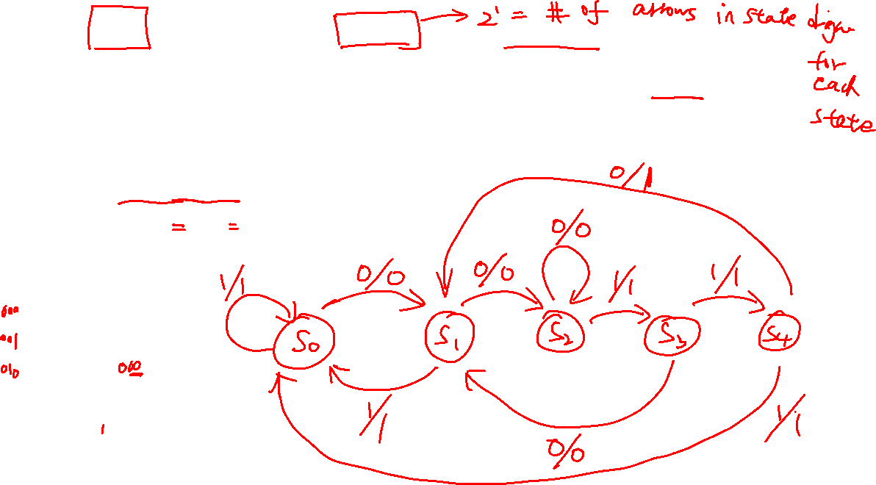

Slide 12
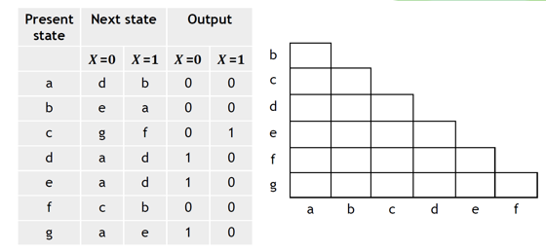

4. State reduction
Two states having different outputs for the same inputs are not equivalent. Two states that are not equivalent are marked with a cross (X) in the corresponding square whereas their equivalence is recorded with a check mark (✓)

Slide 13
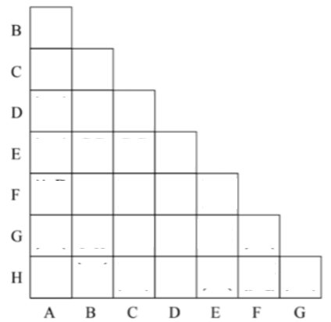
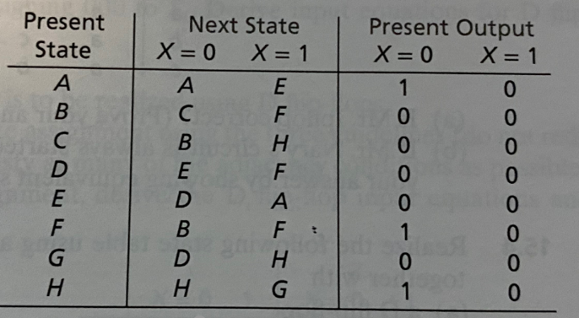



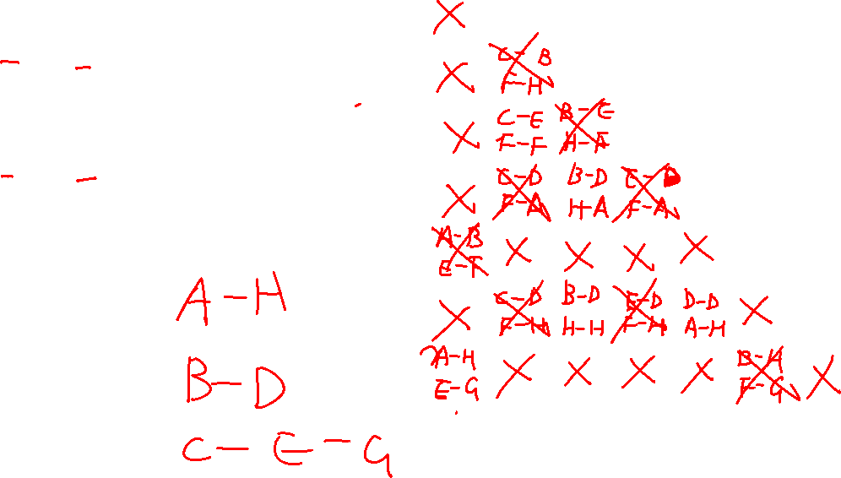



Slide 14
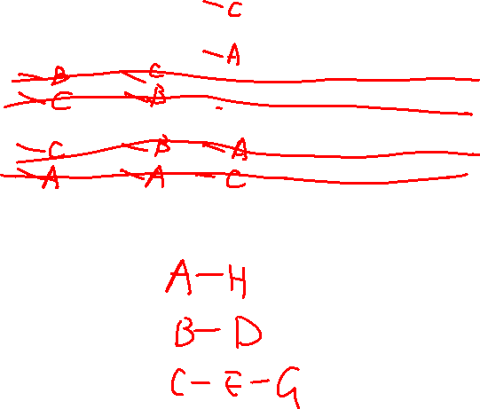

Slide 15
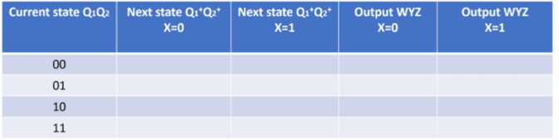
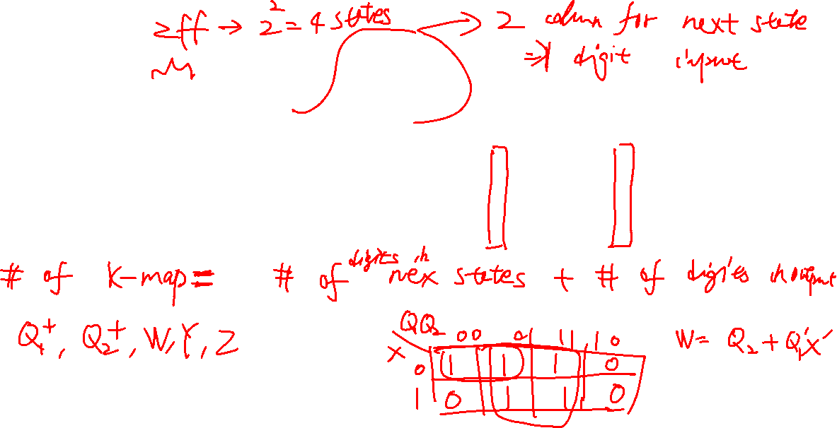
00
11
111
000
11
00
110
111
10
01
011
000
11
10
111
110

